Slide 1
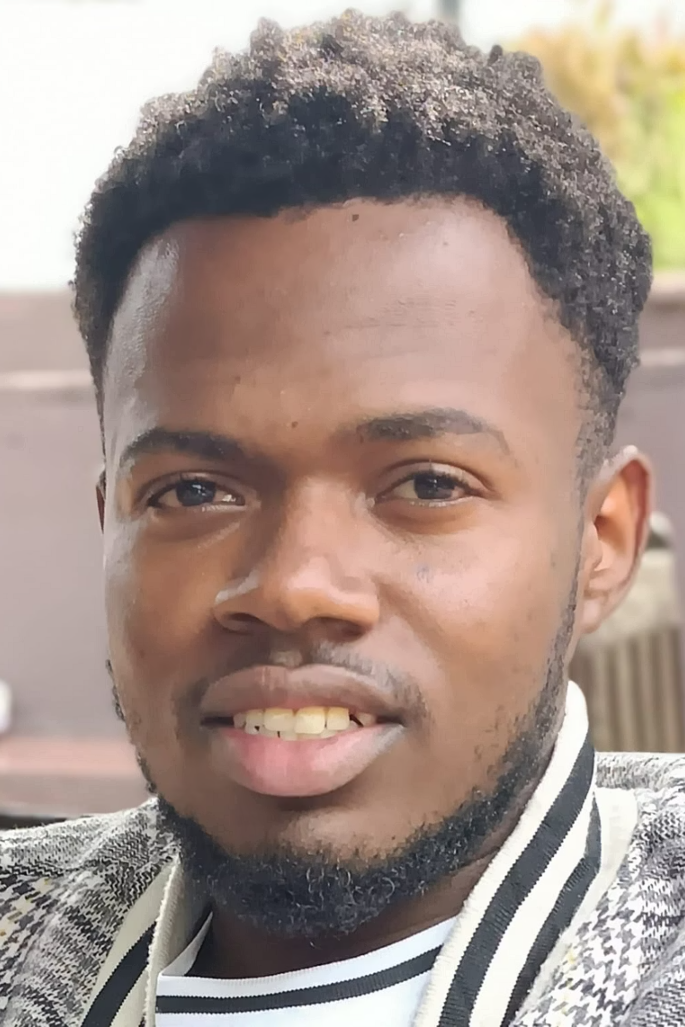
Navigating Horizons: The Journey of Evans Mwaura
A Journey of Resilience, Growth, and Technology
Presenter: Evans Mwaura Mburu
Date: August 12, 2025
Affiliation: Dedan Kimathi University of Technology

Slide 2
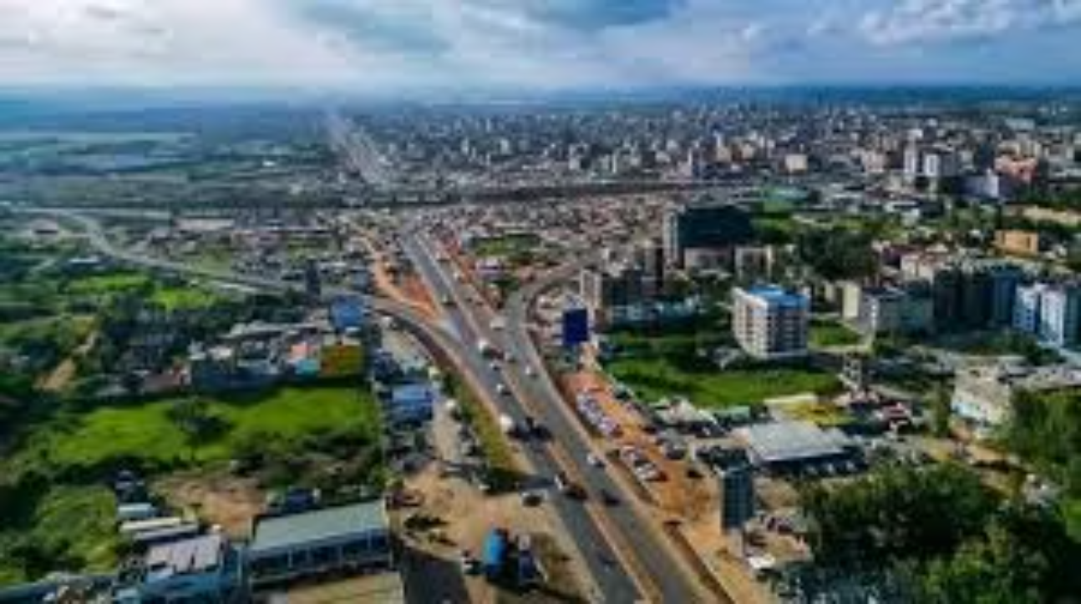
Roots & Origins: Ruiru, Kiambu
Born on August 19, 2003, in Rongai, my early life was shaped by the vibrant, bustling urban center of Ruiru, Kiambu. This dynamic environment instilled in me a profound sense of resilience, adaptability, and a strong appreciation for community.
Proudly Kikuyu, I embrace a rich cultural heritage and traditions that have guided my upbringing and continue to influence my perspective. Growing up amidst diverse experiences in Ruiru provided a unique foundation for understanding different viewpoints and navigating complex social landscapes.
The blend of urban energy and cultural roots has been a key influence, fostering a pragmatic yet deeply connected approach to life and learning.

Slide 3
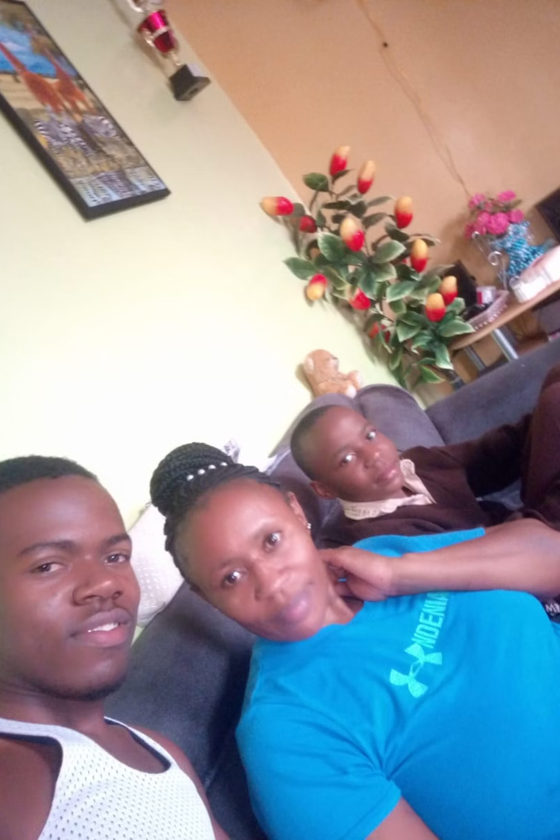




The Foundation: Family & Values
Pillars of Support
Core Values
Mr. and Mrs. Mburu, my parents, have been the unwavering pillars of my upbringing, providing constant support and guidance.
They instilled in me strong moral values, emphasizing the importance of hard work, integrity, and perseverance in all aspects of life.
Brotherhood & Leadership
Growing up with a younger brother fostered essential leadership skills, cooperation, and a deep sense of responsibility as a role model.

Slide 4
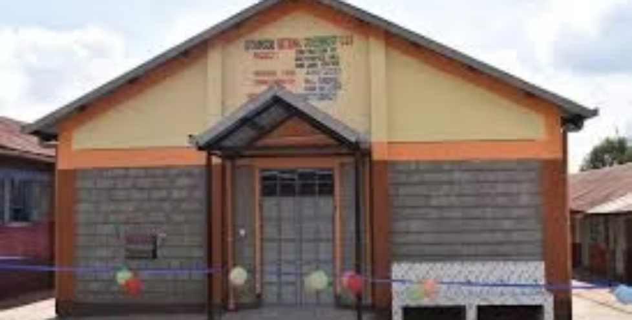
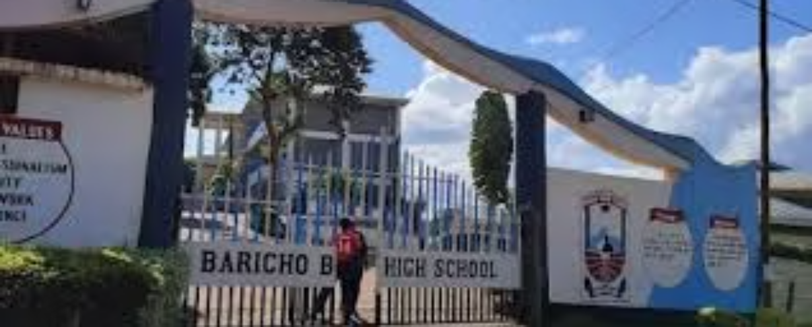
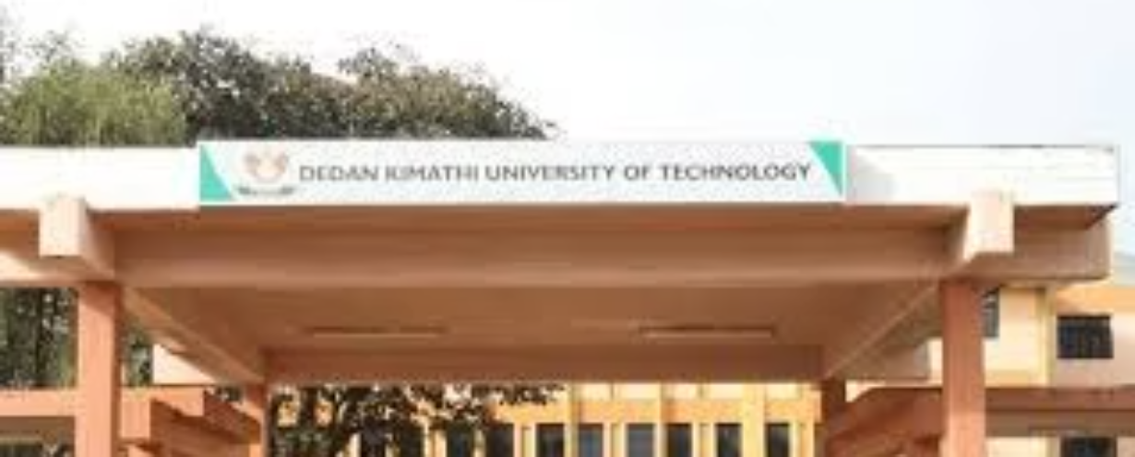
Academic Milestones: From Primary to University
Primary Years (2006–2017)
University (Current)
Attended Terezza Nuzzo and Kagema Primary, achieving a KCPE score of 389, laying a strong academic groundwork.
Currently pursuing a B.Sc. in Computer Science at Dedan Kimathi University of Technology, with an expected graduation in March 2026.
1
2
3
High School (2018–2021)
Graduated from Baricho Boys’ High School with an A-, successfully navigating the unprecedented challenges posed by the global pandemic.

Slide 5
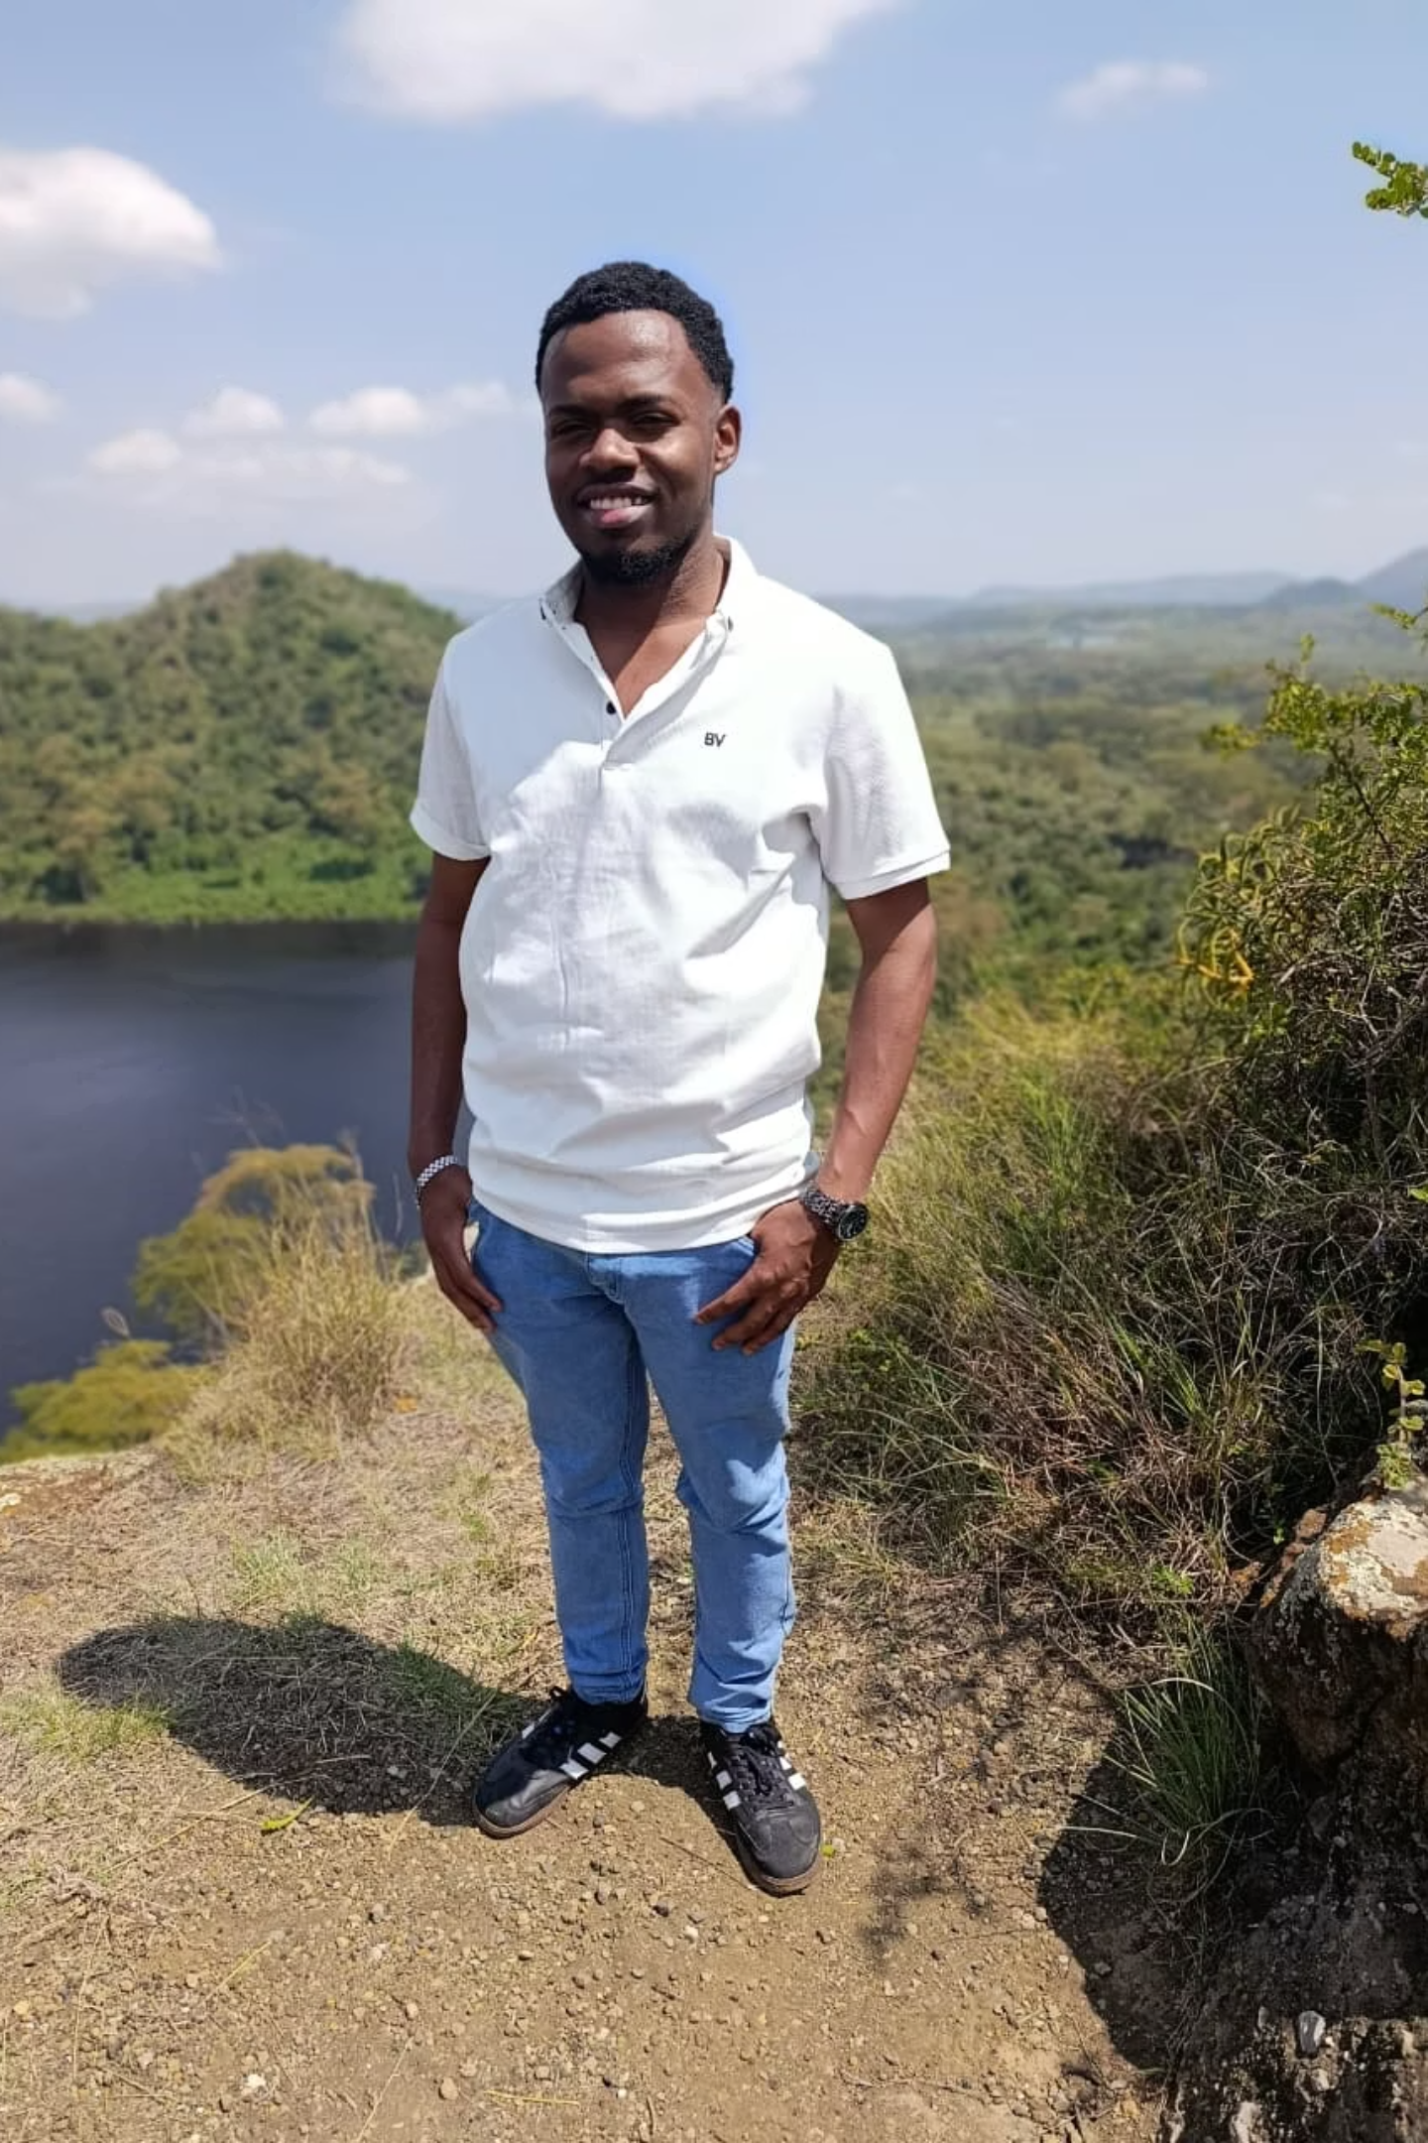


Personal Growth, Hobbies & Values
Core Values
My life is guided by a steadfast commitment to discipline, humility, and an insatiable curiosity, shaping my approach to every challenge.
Inquisitive Mind
A deep passion for understanding how the world operates, from the intricacies of human psychology to the vastness of astronomy, drives my continuous learning.
Exploration & Culture
I've explored the breathtaking Great Rift Valley and various regions across Kenya, connecting with diverse cultures and broadening my perspective.
Growth Philosophy
I firmly believe that "Growth often happens in discomfort," embracing challenges as opportunities for personal and intellectual development.

Slide 6
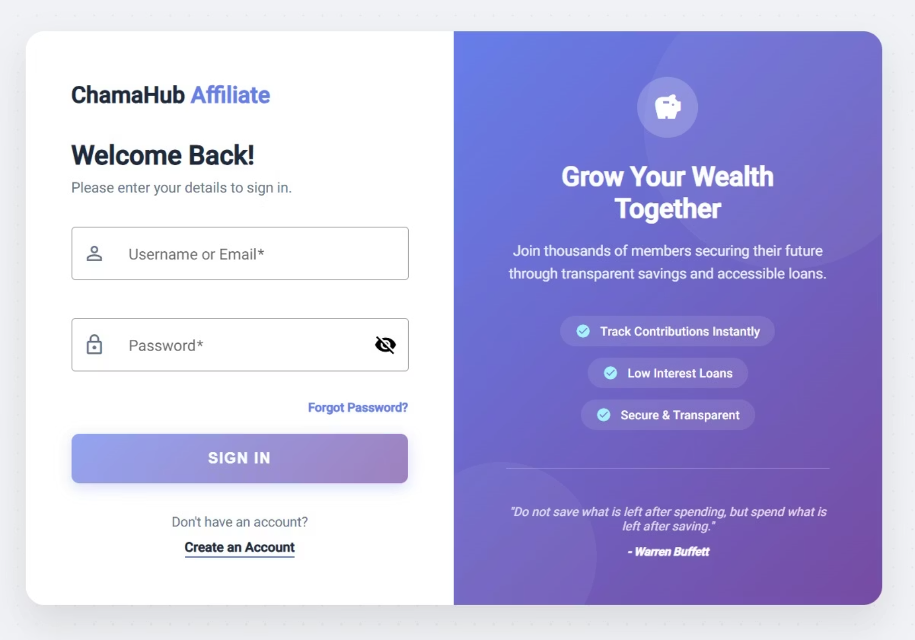
Future Vision: Tech for Social Impact
My ultimate career goal is to evolve into a highly skilled Software Developer and Cybersecurity Professional. I am driven by the desire to leverage technology for meaningful social impact.
I specialize in Spring Boot for robust backend development and Angular for dynamic, user-friendly frontend applications, focusing on building scalable web solutions.
My mission is to design and implement secure, user-centered systems that effectively address critical real-world problems in sectors such as finance, health, and governance. I aspire to innovate responsibly, bridging digital divides and empowering communities through accessible and secure technological solutions.

Slide 7

Technical Expertise: Backend & Frontend
Spring Boot
Angular
Proficient in developing robust and scalable backend applications using Spring Boot, ensuring high performance and reliability.
Skilled in crafting dynamic and responsive user interfaces with Angular, focusing on intuitive user experience and modern web design principles.
Database Management
Experienced in database design and management, ensuring efficient data storage, retrieval, and integrity for complex applications.

Slide 8



Cybersecurity Focus: Protecting Digital Assets
Threat Analysis
Secure Development
A keen understanding of current cybersecurity threats and vulnerabilities, enabling proactive defense strategies.
Integrating security best practices throughout the software development lifecycle to build inherently secure applications.
Data Privacy
Committed to implementing robust data privacy measures and compliance with relevant regulations to protect sensitive information.

Slide 9




Impact & Innovation: Bridging Digital Divides
Empowering Communities
Developing accessible technology solutions that empower underserved communities and foster digital inclusion.
Responsible Innovation
Driving innovation with a strong ethical compass, ensuring technology serves humanity's best interests.
Global Reach
Aspiring to create solutions with a global impact, addressing challenges on a broader scale.

Slide 10


The Journey Ahead: Continuous Learning & Contribution
My journey is one of continuous learning, adaptation, and a steadfast commitment to making a meaningful contribution through technology.
01
Mastering New Technologies
Dedicated to staying at the forefront of technological advancements, constantly acquiring new skills and expertise.
02
Collaborative Development
Eager to collaborate with diverse teams, contributing to innovative projects that push the boundaries of what's possible.
03
Mentorship & Growth
Seeking opportunities to mentor others and be mentored, fostering a culture of shared knowledge and continuous improvement.
04
Shaping the Future
Committed to using my skills to shape a more secure, connected, and equitable digital future for all.

